Slide 1
Micro-learning: Applying the Right Knowledge at The Right Time To Solve Real-World Problems

Slide 2
Objectives
Define what a micro-learning is.
Identify benefits and limitations of micro-learning.
Determine opportunities for using micro-learning
Define best practices for micro-learning
Identify the elements of a micro-learning.
Create a micro-learning outline.

Slide 3
Instructional Goal
Become equipped with the skills needed to develop a micro-learning training.

Slide 4
Poll Question
Defining what micro-learning means is
a great place to start!
Who has heard of the term micro-learning?

Slide 5
What do you think of when you hear the term micro-learning?
Defining what micro-learning means is
a great place to start!
Answer in the chat.

Slide 6
Define and Identify Micro-learning
1
In the digital learning industry:
Short eLearning course
Single learning outcome
Low effort, fast and ready to use
Bite sized nuggets of information
Purpose:
To help workers fix, solve, and improve processes at work and on the job.

Slide 7
Where have you encountered micro-learning in your daily life?
YouTube videos
Vimeo
Google Search

Slide 8
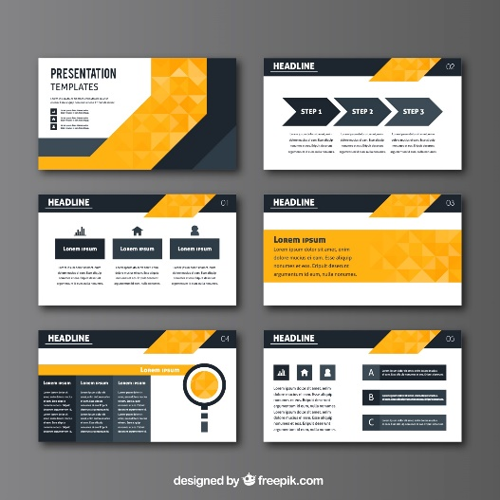
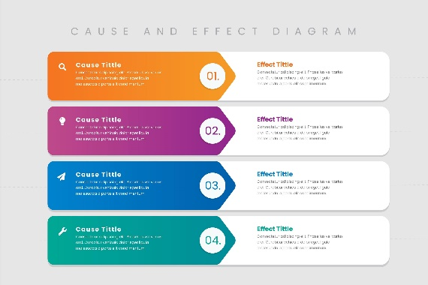
Types of Media
Videos
PowerPoint
PDF
Infographics

Slide 9
Benefits & Limitations of Using Micro-learning
2
What comes to mind when you consider the benefits and limitations of creating and using micro-learning in training?

Slide 10
Benefits & Limitations
Benefits
Limitations

Slide 11
Benefits & Limitations
Benefits
Limitations
Less cognitive load
Rabidly fills performance gaps
Just in time training
Cost efficient
Less time needed by learner
Boosts learner motivation and knowledge retention
Learner centric
Accessible
Short development time
Easy to update

Slide 12
Benefits & Limitations
Benefits
Limitations
Less cognitive load
Not suitable for complex tasks or in-depth training
Cannot be used as stand-alone training
Rabidly fills performance gaps
Just in time training
Cost efficient
Less time needed by learner
Boosts learner motivation and knowledge retention
Learner centric
Accessible
Short development time
Easy to update

Slide 13
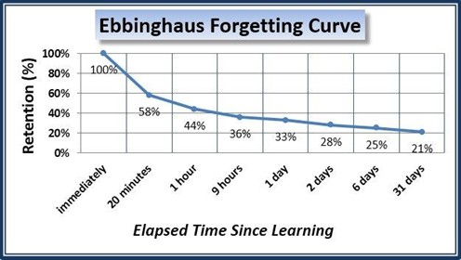
Opportunities to Use Micro-learning for Training
3
We forget nearly 80% of what we learn in 30 days if there is no reinforcement.

Slide 14
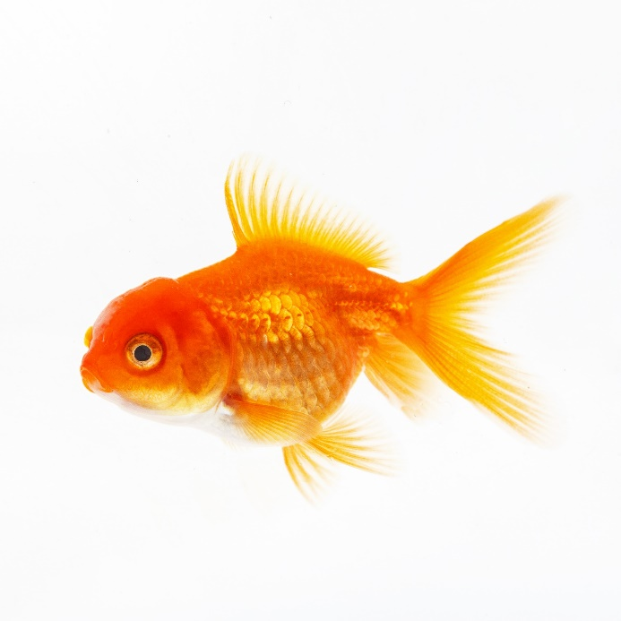
90/20/8 Rule
Human Attention Span
People are completely alert in the first 8 minutes of training
Once 20 minutes go by, the attention level starts showing a dip
Once they hit the 60-120 minute ranges, the alertness level completely drops
Human attention span (8 seconds) is less than that of a goldfish (9 seconds)

Slide 15
Which of these would be considered micro-learning?
Watching small instructional videos
Flashcard learning
Solving mini-training quizzes
Emails, sims or IM
Formal training with instructor
Supplement to formal training word document
Performance support or job aid pdf
Poll question:
All of them
Most of them
None of them

Slide 16
Best Practice for Micro-learning Design
4
Align micro-learning around moments of need
Design for micro-behaviors
Start micro-learning with an emotional hook
End micro-learning with a call-to-action
Surround live events with micro-learning

Slide 17
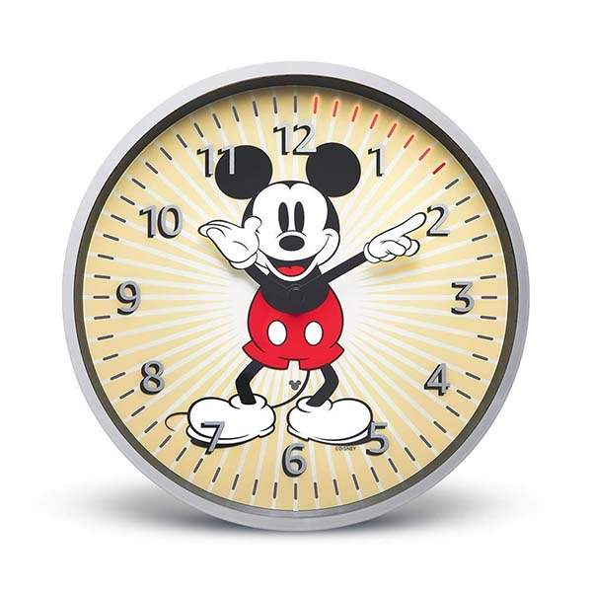
3:00
Come back in 3 minutes!
Count Down

Slide 18
Elements of Micro-learning
5
Short (1-5 minutes)
Focused (one learning objective)
Stands alone (no pre-knowledge needed)
Interactive (learners can apply what they know)
Responsive (works on multiple devices)

Slide 19
Create a Micro-learning Design Outline
6
You will be given an objective and you and your group will:
Determine the media you will use
Identify a moment of need
Identify a target of micro-behavior
Create a call-to-action
Use the elements of micro-learning and list how you might use the elements to create your micro-learning project.

Slide 20
Create an outline to design a micro-learning. Come up with an idea for an outline using your assigned objective.
Course Title:
Learner Characteristics
Learner Description:
Environment for Learning:
Desired connection to the content:
Current Competence Model
What outcomes are desired?
How can the outcome be achieved?
What are the current gaps to be addressed?
What approach will be used to teach the learner how to achieve the outcome?
Microlearning Focus
Can this microlearning be delivered in 5 minutes or less? |  |  | Yes |  | No
Emotional States and Choices
What are the emotional states required for learner engagement?
What are the emotional states required for achieving the outcome?
What media could contribute to achieving the outcomes, including emotional states?
Key Messages/Points
What are the key points or messages to be presented?
How will the points be chunked into smaller bites?
Use the table below to organize your content. Add more rows if needed.
Time/Duration | Media |  |  | Description
 |  |  |  | Content:
Use this outline in your breakout room to fill out the micro-learning design according to the assigned objective.

Slide 21
Wrap-up and Survey
Thank you for your participation. You will receive an email with a survey link after this course.
Linda Smith linda.smith3@anthem.com

