Slide 1
Assessing Youth Mentoring Initiative’s funding gap to provide services for
students-in-need.
Sara Finnigan, Jeff Gastineau & Linda Smith
Indiana University School of Education
R-621 Needs Assessment

Slide 2
CLIENT & AIM
CLIENT
Youth Mentoring Initiative (YMI) is a nonprofit organization in Fishers, Indiana, that collaborates with the Hamilton Southeastern School Corporation to provide caring adults mentors during the school day to help students-in-need navigate various challenges in their lives.
AIM
To assist Youth Mentoring Initiative (YMI) in understanding funding opportunities that will help them close the gap between their current funding and the funding needed as the number of students in need of mentoring increases.

Slide 3
FRAME FACTORS
FRAME FACTORS
Frame factors are internal and external conditions that interfered with timely collection of data.
INTERNAL
A timeline of 12 weeks to collect and analyze data and report findings and recommendations.
EXTERNAL
Building trust with other nonprofits to learn about their fundraising needs and strategies.
Availability of donors to complete our surveys.
Availability of other nonprofit leaders for interviewing.

Slide 4
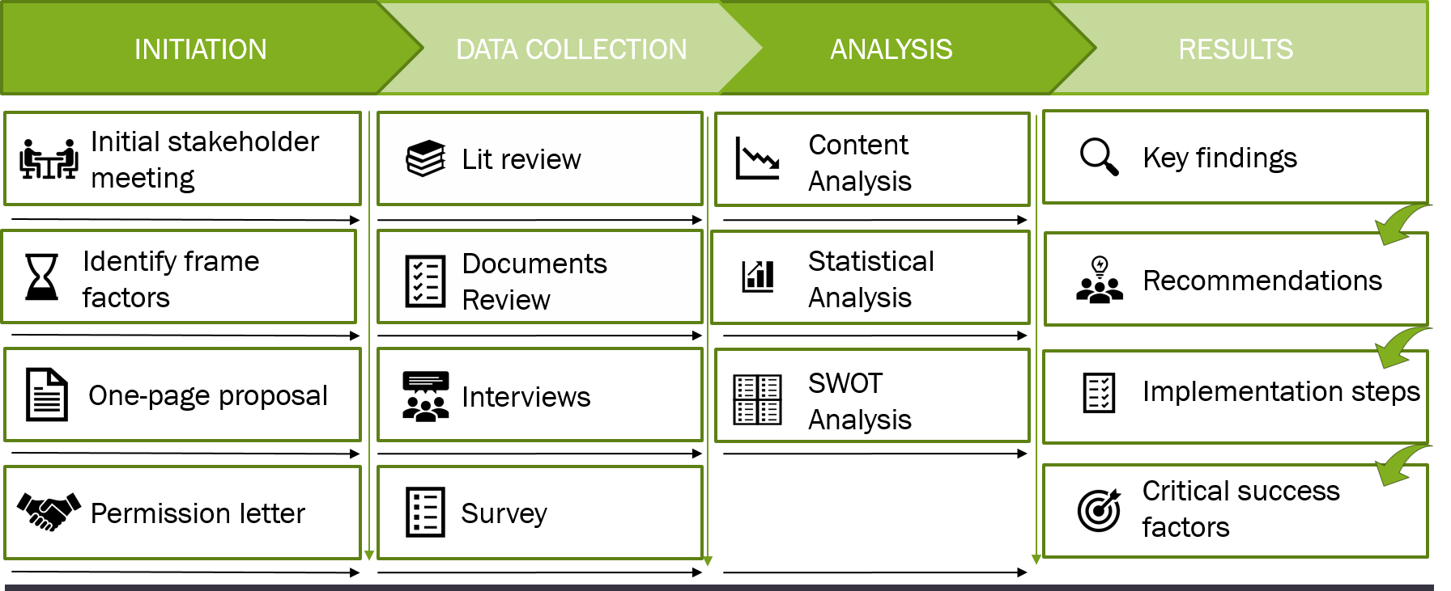
METHODOLOGY
YMI Needs Analysis
METHODOLOGY

Slide 5
SWOT ANALYSIS
YMI Needs Analysis
 | Strengths | Weaknesses
 | Established annual fundraiser. Mission of impacting young people matches the primary reason contributors donate. Stable partnership with HSE Foundation and Fishers City Council. Only organization partnering with the HSE school district for mentoring. Average growth 2018/19 school year has significantly increased. Most mentees rate their experience as good or excellent. Over half of parents/guardians reported an improvement in student behaviors/attitudes | Lack a measurable fundraising goal. Lack a donor management system. Does not produce an annual report. Single fundraiser is insufficient. Not able to retain its donor base. Grants are not dependable. Do no have staffing roles dedicated to building relationships with donors, local government, and business community.
 | Opportunities | Threats
 | Utilize models for future giving needs, communicate fundraising goals, share their mission and vision, and let donors choose how to give. Foundations and corporations giving has increased. Current strong economy may increase giving. National retail chain grants that serve the local community. Digital strategies for donors are becoming easier. Receiving agency certification increases donations. More personal messaging increases giving. | Competition with established local and national nonprofit organizations that also serve at-risk youth. Donors’ inability to differentiate among nonprofit organizations. Prospective donors are less likely to donate than existing donors. Donors make giving decisions based on personal background, preferring charities that they can relate to and that promote their own interests. Changes to tax laws may change donation deductions.
SWOT Analysis
A SWOT analysis helps determine the internal strengths and weaknesses of YMI and the external opportunities and threats to for a better understanding of the current state of funding.
INTERNAL
EXTERNAL

Slide 6
FINDINGS
YMI Needs Analysis
FINDINGS
Strengths | Areas for Improvement
YMI’s mission of serving local students-in-need resonates with donors. YMI has a stable relationship with its two largest grant partners - HSE Schools and the city of Fishers. YMI has an established annual fundraiser at the beginning of the school year. In the last year, YMI has increased its reach by employing campus coordinators and more than doubling the number of its mentor-mentee matches. School staff and students-in-need and their parents/guardians view YMI’s impact positively. | Donations to nonprofit organizations increase when they receive agency certification. YMI’s funding is not keeping pace with its growth. YMI does not retain its donor base. YMI’s donor communication strategy needs fortification. Stronger relationships need to be achieved with donors and the local business community.

Slide 7
RECOMMENDATIONS
YMI Needs Analysis
RECOMMENDATION 1 (Findings 4, 7, 8, 10)
Engage with local business community to increase awareness of YMI’s impact and its partnership with the community.
Implementation
Define the problems YMI solves for the community.
Identify unique attributes that differentiate YMI from other local nonprofit organizations.
Develop messaging tools that articulate the differentiated value YMI brings to the community.
Prioritize community outreach within YMI to establish a community outreach responsibility.
Critical Success Factors
Support from YMI leadership.
Staff to implement and execute the above ideas.
Design resources to execute differentiated messaging.
Focus efforts of community outreach responsibility.

Slide 8
RECOMMENDATIONS
RECOMMENDATION 2 (Findings 1, 2, 9)
Enhance communication strategy by providing transparency about operations and finances to assist in fostering donor relationships.
Implementation
Ensure the database is up to date with current donor contact information.
Conduct surveys to elicit feedback from YMI donor base.
Provide quarterly newsletters via email with donor-preferred content.
Critical Success Factors
Support from YMI leadership.
Staff to implement and execute the above ideas.
Adequate tracking of donor information.
Consistent quarterly newsletter to donors.

Slide 9
RECOMMENDATIONS
YMI Needs Analysis
RECOMMENDATION 3 (Findings 1, 5, 8, 9, 10)
Foster relationships with donors to give them a sense of ownership incentivizing them to commit to the mission, vision and values of YMI.
Implementation
Provide dedicated employees/volunteers to work with donors.
Stay in constant contact and let them know specific successes of their funding.
Ensure donors feel that they belong to the organization.
Give donors a sense of personal identification with YMI’s mission.
Critical Success Factors
Stay in constant contact with donors and let them know the specific success of their funding.
Consistently provide evidence and inform donors of how YMI is progressing toward its goals.
Incorporate opportunities for donor input.

Slide 10
RECOMMENDATIONS
YMI Needs Analysis
RECOMMENDATION 4 (Findings 2, 3, 4, 6, 7)
Improve fundraising strategy by improving existing fundraising efforts and increasing fundraising opportunities to meet the demands of YMI’s growth.
Implementation
Feature client success stories during any fundraising effort.
Conduct a survey to elicit feedback after any major fundraiser.
Add a celebration event in the spring.
Develop a digital fundraising strategy.
Enhance existing fundraiser.
Secure donations from retail corporate sponsors with local in-store programs.
Donations to nonprofit organizations increase when they receive agency certification.
Critical Success Factors
Support from YMI leadership for additional fundraising projects.
Staff to implement and execute on the above ideas.
Tools required to support the additional tasks.

